Slide 1
Links, Images, Tables

Slide 2
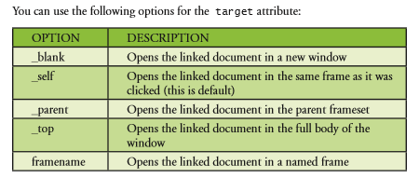

Slide 3
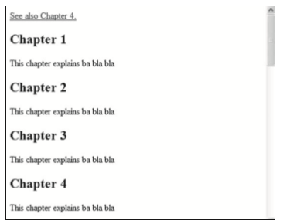
The name attribute
Named anchor syntax:
<a name="label">Any content</a>
The link syntax to a named anchor:
<a href="#label">Any content</a>

Slide 4
Creating a mailto: Link
<a href="mailto:someone@microsoft.com?subject=Hello%20 again"> Send Mail</a>
%20 for spaces
The following example demonstrates how to link to an e-mail address and generate a new e-mail message in your default e-mail application

Slide 5
Insert Images from Different Locations
<p>An image from another folder:</p>
<img src="/images/chrome.gif" width="33" height="32" />
<p>An image from w3schools:</p>
<img src="http://www.w3schools.com/images/w3schools_green. jpg" width="104" height="142" />

Slide 6
Background Image
<body background="background.jpg">

Slide 7
aligning Images
Bottom
<p>The text is aligned with the image <img src="hackanm.gif" align="bottom" width="48" height="48" /> at the bottom.</p>
Middle
<p>The text is aligned with the image <img src="hackanm.gif" align="middle" width="48" height="48" /> in the middle.</p>
Top
<p>The text is aligned with the image <img src="hackanm.gif" align="top" width="48" height="48" /> at the top.</p>
<p><b>Note:</b> The bottom alignment is the default!</p>

Slide 8
Tables

Slide 9
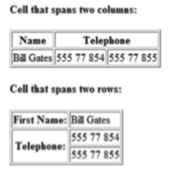
Cells spanning Multiple Columns
<h4>Cell that spans two columns:</h4>
<table border="1">
<tr>
<th>Name</th>
<th colspan="2">Telephone</th> </tr>
<tr>
<td>Bill Gates</td>
<td>555 77 854</td>
<td>555 77 855</td>
</tr>
</table>

Slide 10
Cells spanning Multiple Columns
<h4>Cell that spans two rows:</h4>
<table border="1">
<tr>
<th>First Name:</th>
<td>Bill Gates</td>
</tr>
<tr>
<th rowspan="2">Telephone:</th>
<td>555 77 854</td>
</tr>
<tr>
<td>555 77 855</td>
</tr>
</table>

Slide 11
Assignment

Slide 12
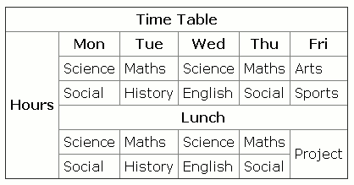

Slide 13
